Slide 1
EDU GRAPH-API Demo Script
Expertise in Microsoft's Azure, Office 365, and SharePoint platforms

Slide 2
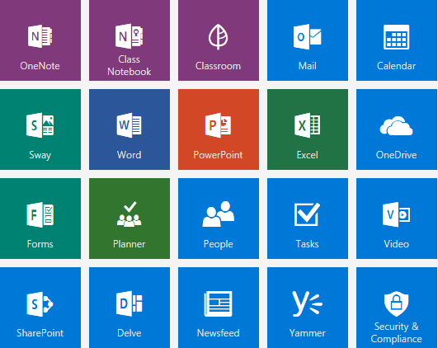
Agenda
Admin Login Authentication Flow
Local Login Authentication Flow
O365 Login Authentication Flow
ALL SCHOOLS
SCHOOL CLASSES
CLASS DETAILS
Sync Data With Web Job

Slide 3
Admin Account Login Authentication Flow

Slide 4
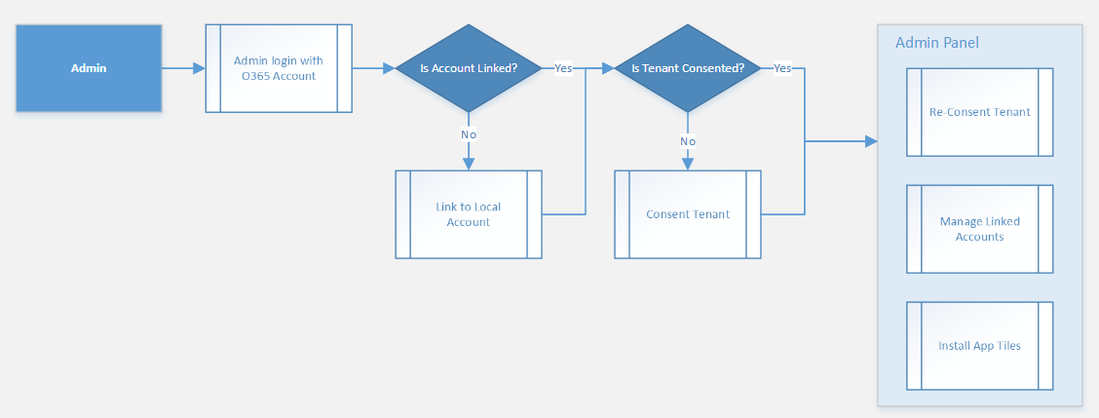
Admin Account Login Authentication Flow

Slide 5
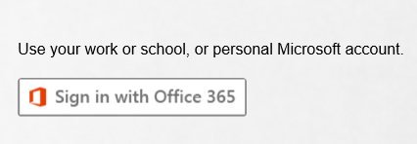
Admin Login with an Office 365 Account
Go to the site login page.
Click the Sign in with Office 365 button.
Login with the Admin account.

Slide 6
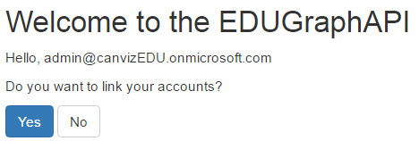
Is Admin Account Linked to a Local Account?
Is the Admin account linked to a local account?
Yes, go to the link account page.
No, go to the schools page.

Slide 7
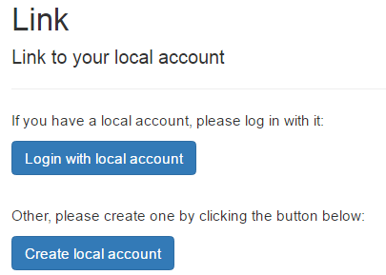
Link the Admin Account to a Local Account
If you have a Local account, login and then link the account.
If you do not have a local account, create a local account and link it.

Slide 8
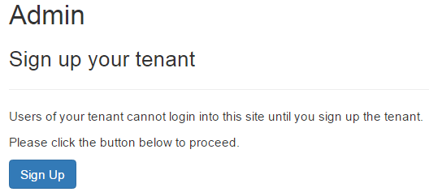
Sign Up Tenant
Click the Sign Up button to sign up the tenant.
After the sign up is complete, go to Admin panel.

Slide 9
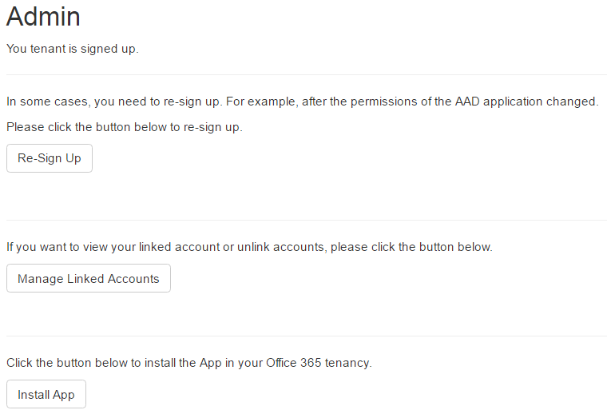
Admin Panel
Click the Re-Sign Up button to re-sign up the tenant (need to login again).
Click the Manage Linked Accounts button to view/unlink accounts.
Click the Install App button to install the App in an Office 365 tenancy.

Slide 10
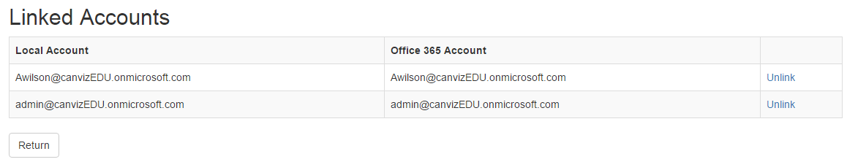
Admin Panel - Manage linked accounts
All linked users are displayed here.
Click the Unlink link to unlink a user.

Slide 11
Local Account Login Authentication Flow

Slide 12
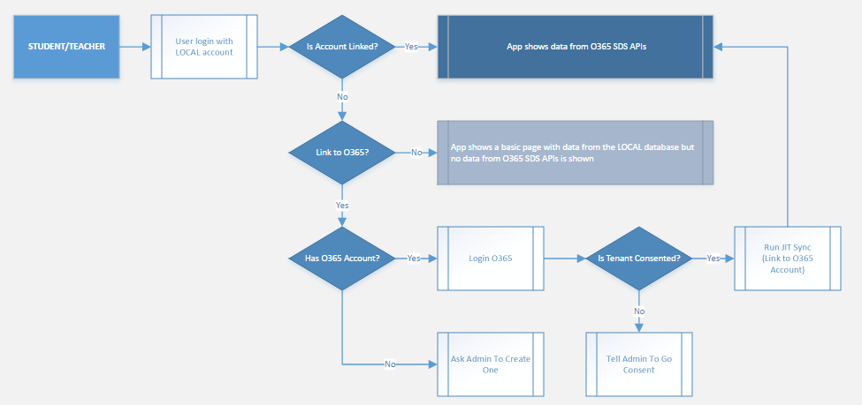
Local Account Login Authentication Flow

Slide 13
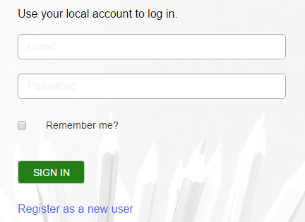
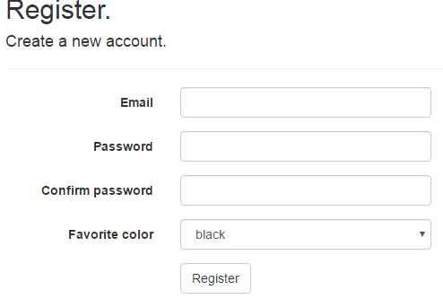
Create Local Account
Go to site login page and click the Register as a new user link.
Fill the form fields: Email, Password etc. , then click the Register button.

Slide 14
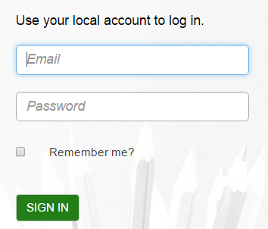
Login with the Local Account
Go to the site login page.
Input email and password.
Click the SIGN IN button.

Slide 15
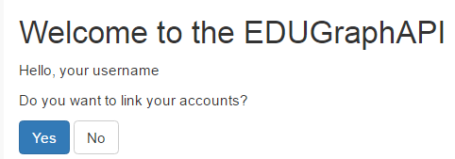
Link the Local Account to an Office 365 Account
Click the Yes button to link the account.
Click the No button to show a basic page and stop.

Slide 16
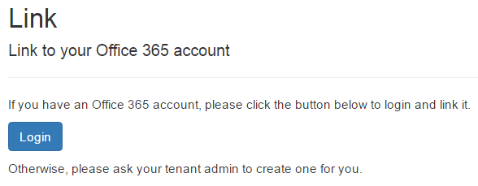
Login to Office 365 and Link the accounts
Click the Login button and login to Office 365.
After the login succeeds the account will link automatically and then go to the all schools page.

Slide 17
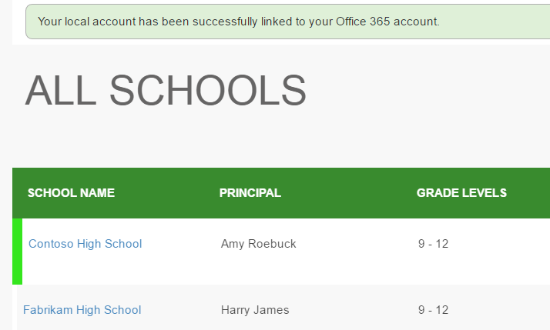
Login succeeded
After linking the accounts succeeds the app displays all schools.

Slide 18
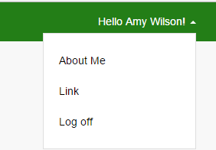
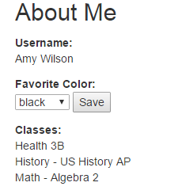
About Me
Click username on top right corner and click “About Me”.
Username will display here.
User’s favorite color will show here and user can change and save it.
If user is linked to O365 his(her) classes will display here.

Slide 19
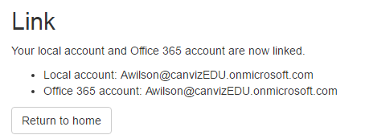
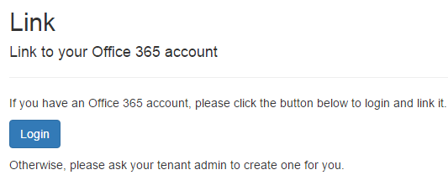
Link
Click username on top right corner and click “Link”.
Here will display link status if account is linked to O365 account.
If local account is not linked to O365 account it will show option “Login” and then link.

Slide 20
Office 365 Login Authentication Flow

Slide 21
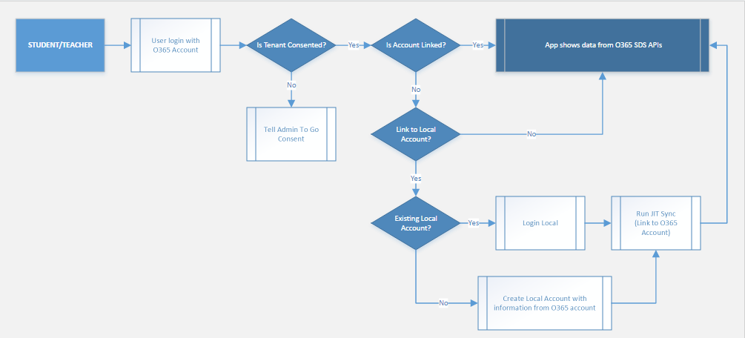
Office 365 Login Authentication Flow

Slide 22
Login with Office 365 Account
Go to the site login page.
Click the Sign in with Office 365 button.
Login with an Office 365 account.

Slide 23
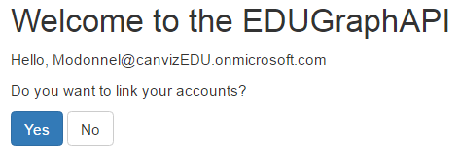
Link an Office 365 Account to a Local Account
Click the Yes button to link the account.
Click the No button to go to the all schools page

Slide 24
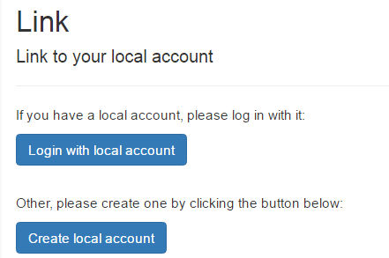
Login with a Local Account and Link the accounts
Click the Login with local account button to login with Local account.
Click the Create local account to create a Local account and then link the accounts.

Slide 25
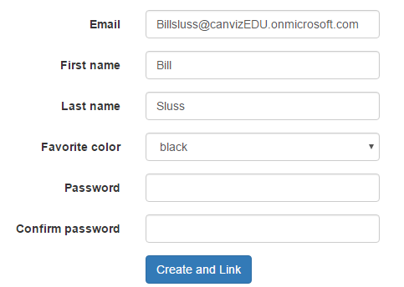
Create a Local Account and Link the accounts
Input the fields Favorite color, Password and Confirm Password.
Select Favorite color.
Click the Create and Link button to create a new local account and then link the accounts.

Slide 26
About Me
Click username on top right corner and click “About Me”.
Username will display here.
User’s favorite color will show here if linked to local account and user can change/save it.
User classes will display here.

Slide 27
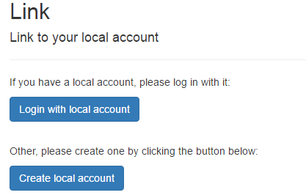
Link
Click username on top right corner and click “Link”.
Here will display link status if account is linked to local account.
If O365 account is not linked to local account it will show link options like “Login with local account” or “Create local account”.

Slide 28
ALL SCHOOLS

Slide 29
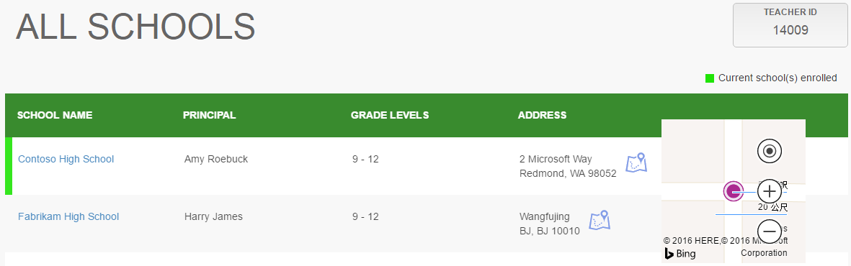
ALL SCHOOLS
Login with a teacher/student account & go to the all schools page.
Teacher/student’s id is displayed in the top right corner.
Current school(s) enrolled are marked with green color.
Click a school name to go to the classes page.
Click the Bing map icon to show a map of the selected school.

Slide 30
SCHOOL CLASSES

Slide 31
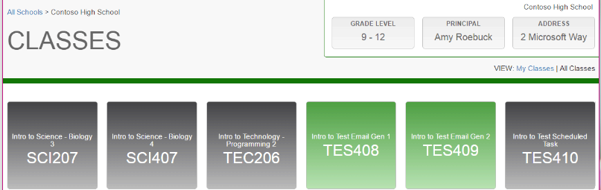
SCHOOL CLASSES
All classes are displayed on the school classes page.
My classes are highlighted with a green color.
Classes that the current users are highlighted with the gray color.
Hover on a class to pop up the class details window.
Click on a green highlighted class to go to the class detail page.
Click the My Classes or All Classes links to switch views.

Slide 32
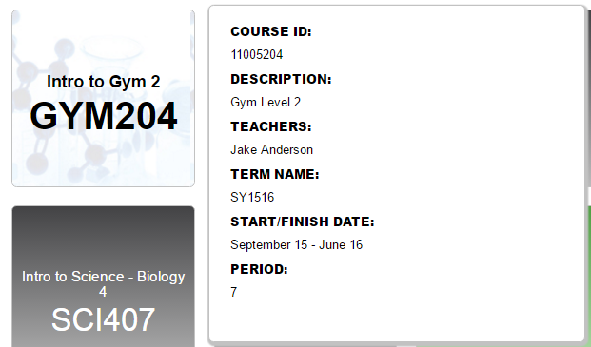
Class detail information
Hover on a class tile to pop up the class detail window.

Slide 33
CLASS DETAILS

Slide 34
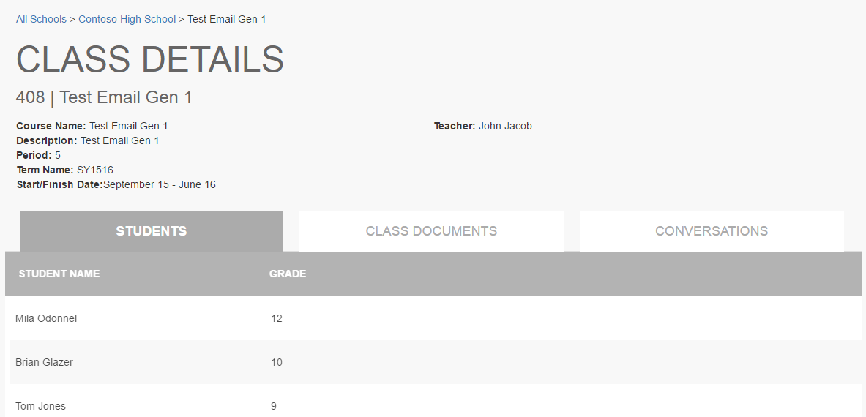
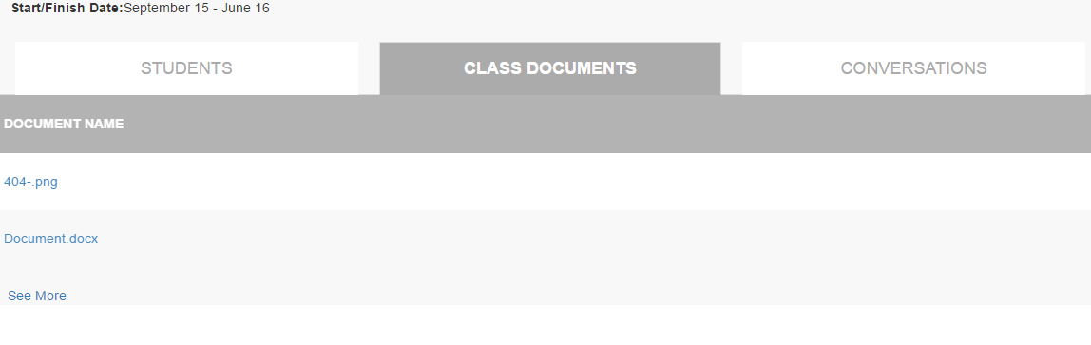
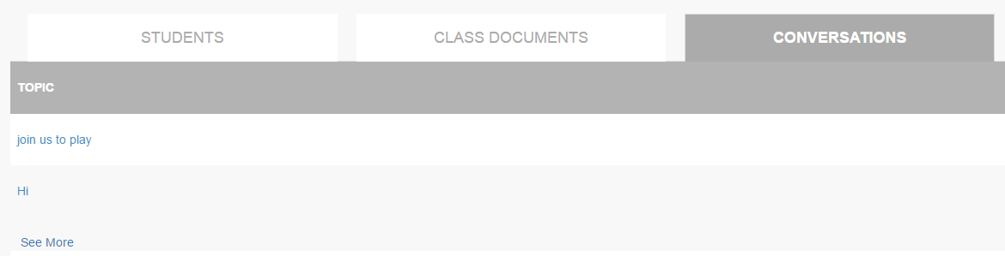
Class detail
Class detail are displayed on this page.
There are 3 tabs containing students, class documents and conversations.
Click each tab to see detailed information.

Slide 35
Sync Data With Web Job

Slide 36
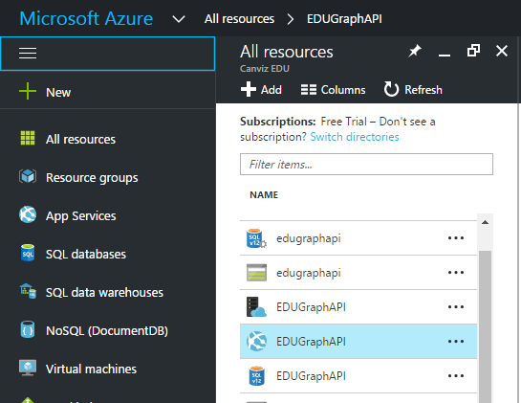
Sync Data With Web Job
Got to https://portal.azure.com and login with the admin account.
Click All resources on the left side of the page. All resources are displayed.
Click the App Service named EDUGraphAPI.

Slide 37
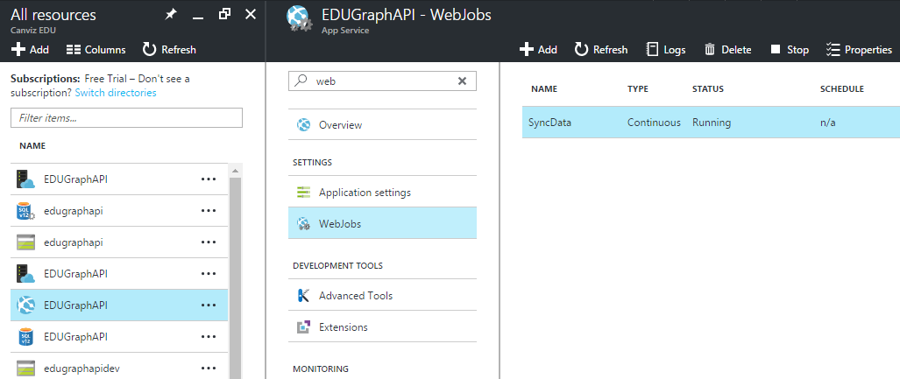
Web Jobs
In the Settings group, click Web Jobs.
Select the job named SyncData, then click Logs.

Slide 38
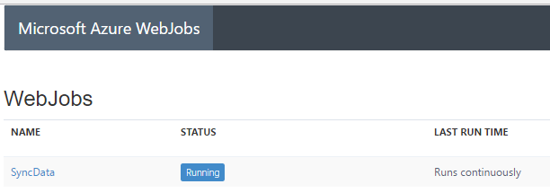
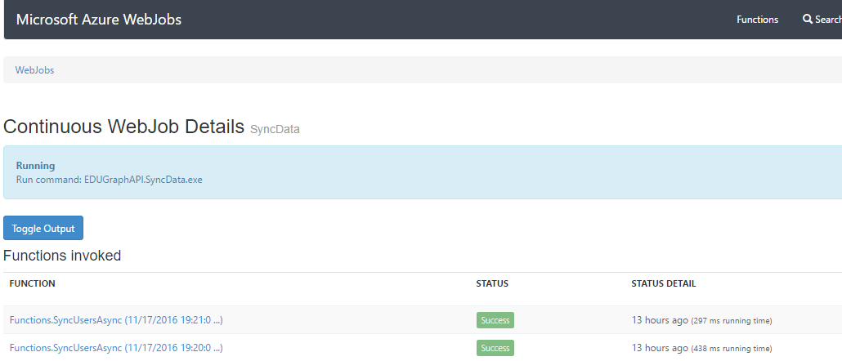
Web Job Logs
Click the SyncData link to see Log details.
On Log detail page click the Toggle Output button to show Log details.

Slide 39
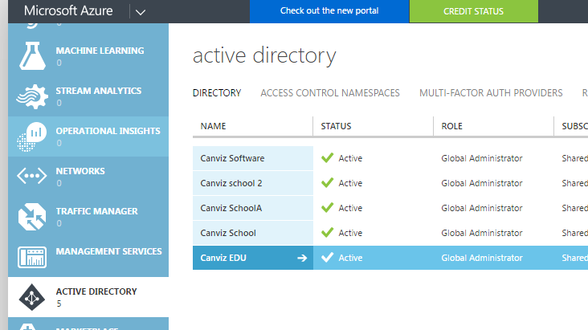
Update AD User Information
Go to https://manage.windowsazure.com/ and login with the admin account.
Click ACTIVE DIRECTORY in the left menu.
Click the AD named Canviz EDU.

Slide 40
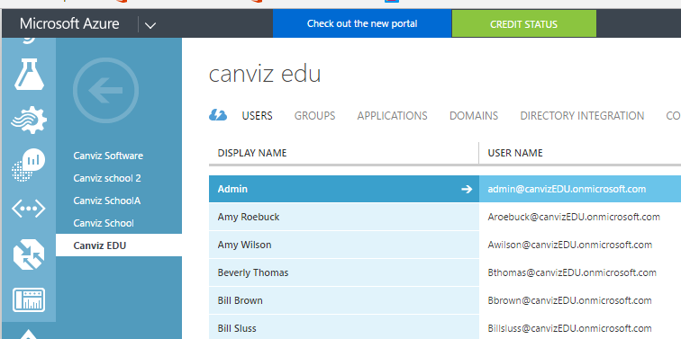
Update AD User Information
Click the Users link to show all the users in the AD.

Slide 41
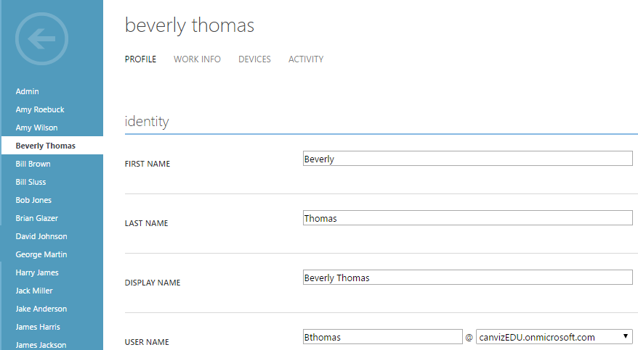
Update AD User Information
Click a user and open the edit page.
Update user information like First name or Last name.
Save the changes.

Slide 42
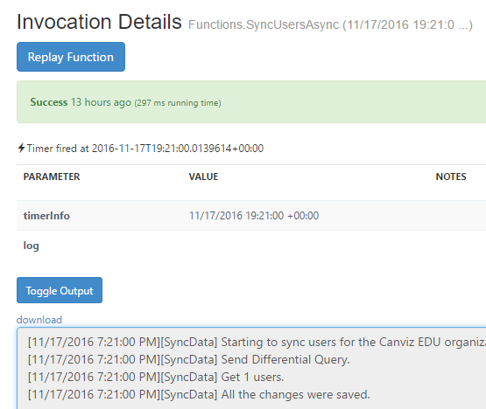
Check Web Job Sync Result
Go back to web job log detail page.
Wait about 1 minute, then refresh the page.
Click the last function invoked to open the detail page.
Click the Toggle Output button.
View the log that shows one item was updated.

